Slide 1
MASK: Redesigning the GPU Memory Hierarchy to Support Multi-Application Concurrency
Authors: Rachata Ausavarungnirun, Saugata Ghose, Adwait Jog, Onur Mutlu
Affiliate: Carnegie Mellon University, University of Texas at Austin, ETH Zürich
Published in: International Conference on Architectural Support for Programming Languages and Operating Systems (ASPLOS’18 CCF A)
Presented by: Junpeng Zhu （朱君鹏）
Advisor: Yin Qian
May 5, 2019

Slide 2


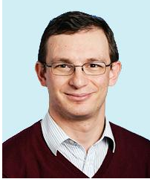
Authors
Now: Postdoctoral Researcher
Education: Ph.D., M.S. and B.S. degrees from Carnegie Mellon University
Interests:
GPU architectures
management of GPUs in the cloud
virtual memory
heterogeneous CPU-GPU architectures
Now: systems scientist in CMU
Education: Ph.D. and M.S. Cornel University, B.S. Binghamton University
Interests:
Memory and storage system
Data-driven architectures
System-level architectural interactions
Now: Professor in CMU and ETH Zürich
Educations: Ph.D. , M.S. UT Austin, B.S. University of Michigan
Interests:
computer architecture
systems
security, and bioinformatics

Slide 3
OUTLINE
Introduction
MASK Design
Methodology
Experiments & Evaluation
Conclusions

Slide 4
Introduction
Graphics Processing Units (GPUs) exploit large amounts of thread-level parallelism to provide high instruction throughput and to efficiently hide long-latency stalls.
Applications from diﬀerent domains can have vastly diﬀerent compute and memory demands on the GPU.
Multiple applications can share a single GPU, akin to how multiple applications execute concurrently on a CPU.

Slide 5
Introduction
A GPU executes hundreds of threads concurrently, where the threads are grouped into multiple warps. The GPU executes each warp in lockstep (i.e., each thread in the warp executes the same instruction concurrently, SIMD).
When one or more threads of a warp stall, the GPU hides the latency of this stall by scheduling and executing another warp.

Slide 6
Introduction
Multi-application concurrency requires several support mechanisms in both hardware and software.
For the CPU, One such key mechanism is virtual memory, which manages and protects the address space of each application.
modern GPUs lack the extensive support for multi-application concurrency available in CPUs.
as a result suﬀer from high performance overheads when shared by multiple applications
In this paper, the key result is that that the poor performance is largely a result of the virtual memory mechanisms employed in modern GPUs.

Slide 7
Introduction
Poor address translation performance is a key obstacle to efficient GPU sharing.
For single-application execution, State-of-the-art address translation mechanisms were designed
For multiple applications spatially share the GPU, it exists inter-application interference
This contention leads to frequent misses in the shared translation lookaside buﬀer (TLB), where a single miss can induce long-latency stalls for hundreds of threads.
As a result, the GPU often cannot schedule enough threads to successfully hide
the stalls, which diminishes system throughput and becomes a
first-order performance concern.

Slide 8
Introduction
Based the above analysis, the propose MASK, a new GPU framework that provides low-overhead virtual memory support for the concurrent execution of multiple applications
The goal in this work is to develop new techniques that can alleviate the severe address translation bottleneck in state-of-the-art GPUs
Multi-Address Space Concurrent Kernels (MASK)

Slide 9
OUTLINE
Introduction
MASK Design
Methodology
Experiments & Evaluation
Conclusions

Slide 10
MASK Design
MASK is a framework that provides memory protection support and employs three mechanisms in the memory hierarchy to reduce address translation overheads
TLB-Fill Tokens regulate the number of warps that can fill (i.e., insert entries) into the shared TLB in order to reduce TLB thrashing
Address-Translation-Aware L2 Bypass mechanism significantly increases the shared L2 data cache utilization
Address-Space-Aware DRAM Scheduler reduces interference between address translation requests and data demand requests

Slide 11
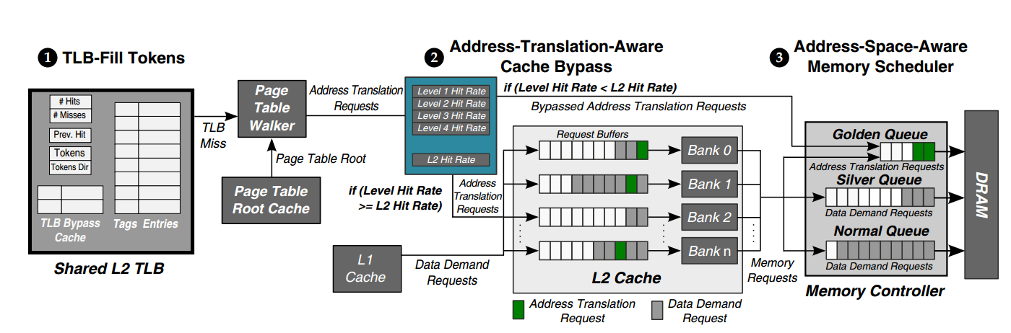
MASK Design

Slide 12
MASK Design
MASK provides memory protection by allowing diﬀerent GPU cores to be assigned to diﬀerent address spaces
MASK uses per-core page table root registers (similar to the CR3 register in x86 systems) to set the current address space on each core.
The page table root register value from each GPU core is also stored in a page table root cache for use by the page table walker.

Slide 13
MASK Design
MASK with a new mechanism called TLB-Fill Tokens
To reduce inter-address-space interference at the shared L2 TLB
MASK use an epoch- and token-based scheme to limit the number of warps from each GPU core that can fill (and therefore contend for) the L2 TLB. While every warp can probe the shared L2 TLB, only warps with tokens can fill the shared L2 TLB
MASK uses TLB-Fill Tokens to reduce thrashing

Slide 14
OUTLINE
Introduction
MASK Design
Methodology
Experiments & Evaluation
Conclusions

Slide 15
Methodology
To evaluate MASK, It models the NVIDIA Maxwell architecture, and the TLB-fill bypassing, cache bypassing, and memory scheduling mechanisms in MASK, using the Mosaic simulator, which is based on GPGPU-Sim 3.2.2.

Slide 16
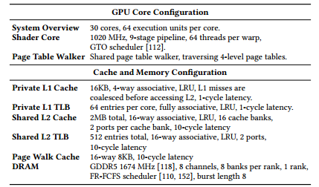
Methodology

Slide 17
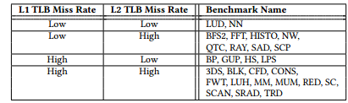
Methodology
We randomly select 27 applications from the CUDA SDK

Slide 18
OUTLINE
Introduction
MASK Design
Methodology
Experiments & Evaluation
Conclusions

Slide 19
Experiments & Evaluation
Static, uses a static spatial partitioning of resources
PWCache, models the page walk cache baseline design
SharedTLB, models the shared L2 TLB baseline design
Ideal, represents a hypothetical GPU where every single TLB access is a TLB hit

Slide 20
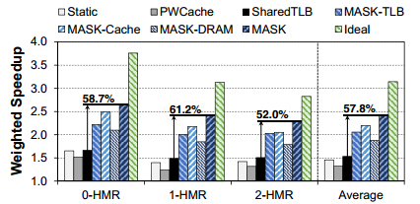
Multiprogrammed Workload Performance
Compared to SharedTLB, which is the best-performing baseline, MASK improves the weighted speedup by 57.8% on average
MASK performs only 23.2% worse than Ideal (where all accesses to the L1 TLB are hits)

Slide 21
Component-by-Component Analysis
Eﬀectiveness of TLB-Fill Tokens
MASK uses TLB-Fill Tokens to reduce thrashing
The hit rates for Static and SharedTLB are substantially similar
MASK-TLB increases shared L2 TLB hit rates by 49.9% on average over SharedTLB
TLB-Fill Tokens mechanism reduces the number of warps utilizing the shared L2 TLB entries

Slide 22
Component-by-Component Analysis
Eﬀectiveness of Address-Translation-Aware L2 Bypass
MASK uses Address-Translation-Aware L2 Bypass with the goal of prioritizing address translation requests
Address-Translation-Aware L2 Bypass is very eﬀective at selecting which blocks to cache, resulting in an address translation request hit rate that is higher than 99% for all of our workloads
Address-Translation-Aware L2 Bypass minimizes the impact of long L2 cache queuing latency [16], leading to a 43.6% performance improvement compared to SharedTLB

Slide 23
Component-by-Component Analysis
Eﬀectiveness of Address-Space-Aware DRAM Scheduler
MASK is eﬀective at reducing the DRAM latency of address translation requests, which contributes to the 22.7% performance improvement of MASK-DRAM over SharedTLB

Slide 24
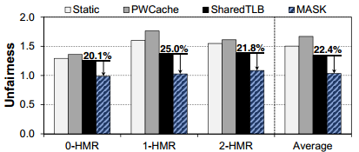
Multiprogrammed Workload Unfairness
Compared to statically partitioning resources (Static), MASK provides better fairness by allowing both applications to access all shared resources.
Compared to SharedTLB, which is the baseline that provides the best fairness, MASK reduces unfairness by 22.4% on average.

Slide 25

Scalability
In general, as the application count increases, contention for shared resources (e.g., shared L2 TLB, shared L2 cache) draws the performance for both SharedTLB and MASK further from the performance of Ideal.
MASK is eﬀective at reducing the amount of contention at the heavily-contended shared TLB.

Slide 26
OUTLINE
Introduction
MASK Design
Methodology
Experiments & Evaluation
Conclusions

Slide 27
Conclusions
MASK consists of three novel address-translation-aware cache and memory management mechanisms that work together to largely reduce the overhead of address translation:
a token-based technique to reduce TLB contention,
a bypassing mechanism to improve the eﬀectiveness of cached address translations, and
an application-aware memory scheduling scheme to reduce the interference between address translation and data requests.
Notes:
Our evaluations show that MASK restores much of the throughput lost to TLB contention. Relative to a state-of-the-art GPU TLB, MASK improves system throughput by 57.8%, improves IPC throughput by 43.4%, and reduces applicationlevel unfairness by 22.4%. MASK’s system throughput is within 23.2% of an ideal GPU system with no address translation overhead.

Slide 28
Conclusions
The evaluations show that MASK restores much of the throughput lost to TLB contention.
Relative to a state-of-the-art GPU TLB, MASK improves system throughput by 57.8%, improves IPC throughput by 43.4%, and reduces applicationlevel unfairness by 22.4%.
MASK’s system throughput is within 23.2% of an ideal GPU system with no address translation overhead.

Slide 29
Thanks & Comments!

